Slide 1
Automata and Theory of Computation
CSE 417
DFA
Notes:
Farazul H Bhuiyan
Lecturer
Dept. of CSE
BRAC University
Bangladesh

Slide 2
Example: Recognizing Strings Ending in “ing”
Finite Automata
Not i or g
Not i
Not i or n
i
nothing
Saw i
Saw in
Saw ing
i
n
g
i
i
Start
Not i

Slide 3
Finite Automata
Finite automata is a finite state machine
The machine is designed to specify a language
Finite automata works in states
Takes an input string and determines whether the string belongs to that language or not
String
Finite Automata
Belongs to the Language or not

Slide 4
Finite Automata
Finite Automaton, M:
M ={Q, Σ, δ, q₀, F}
Q={Set of Finite States}
Σ={Set of Alphabets}
δ = transition rules
current_state, symbol -> next_state
q₀ =Initial State
F={Set of accepting states}

Slide 5
Finite Automata
For example: Recognizing Strings Ending in “ing”
Finite Automaton, M:
M ={Q, Σ, δ, q₀, F}
Q={Nothing, saw i, saw in, saw ing}
Σ={A… Z, a…z}
δ -
q₀ =Nothing
F={saw ing}

Slide 6
Given Σ={a,b}, design the machine that accepts any string having at least one a and one b Given Σ={0,1}, design the machine that accepts any string starting with 01 and ending with 01
Practice Problems

Slide 7
Components of FA
Alphabet
A finite set of symbols.
An alphabet is often denoted by sigma(Σ).
Yet can be given any name.
B = {0, 1} Says B is an alphabet of two symbols, 0 and 1.
C = {a, b, c} Says C is an alphabet of three symbols, a, b and c.
Sometimes space and comma are in an alphabet while other times they are meta symbols used for descriptions.

Slide 8
Components of FA
Symbol
Alphabet
String
Language

Slide 9
Components of FA
Symbol
A character, mark.
An abstract entity that has no meaning by itself, often called uninterpreted.

Slide 10
Components of FA
Alphabet
A finite set or collection of symbols.
An alphabet is often denoted by sigma(Σ).
All the strings will be based on alphabet.
Ex.
A = {0, 1} Says A is an alphabet of two symbols,
a and b. ✖
1 and 0. ✓
C = {a, b, c} Says C is an alphabet of three symbols, a, b and c.

Slide 11
Components of FA
String
A sequence of symbol(s) from an alphabet.
Ex. If Σ = {a, b}, then
a, b, aa, ab, aab …. can be the strings
Vertical bars around a string indicate the length of a string expressed as a natural number.
For example |a| = 1, |aab| = 3

Slide 12
Components of FA
Language
Collection of strings
Ex. If Σ = {a, b}, then
Language L₁ = set of all stings of length 3
= {aaa, aab, aba, abb, baa, bba, bab,bbb}
Thus, L₁is finite
Ex. If Σ = {a, b}, then
Language L₂ = set of all stings starting with a
= {a, aa, ab, abba, abb, … }
Thus, L₂is infinite

Slide 13
Finite Automata
Finite automata determines whether a sting belongs to the given language or not
Ex: language L₁ is the set of all stings starting with a of Σ = {a, b}
= {a, aa, ab, abba, abb, … }
a/b
a
String₁ = bbaa
States = Q3->Q3->Q3->Q3
String₁ = abba
States = Q2->Q2->Q2->Q2
Q1
Q2
b
Q3
a/b

Slide 14
Finite Automata
Construct a DFA that accepts all strings over {0,1} of length exactly 2
L= {00, 01, 10, 11}
Construct a DFA that accepts all strings over {0,1} where string length is at least 2
L={00, 01, 10, 11, 000, 010 …}
Construct a DFA that accepts all strings over {0,1} where string length is at most 2
L= {ε ,0,1,00, 01, 10, 11}

Slide 15
Finite Automata
DFA – Deterministic Finite Automata
NFA – Non-Deterministic Finite Automata

Slide 16
DFA
Construct a DFA that accepts all strings over {0,1} of length 2
Σ={0,1}
Construct a DFA that accepts all strings over {0,1} that contains 1
Σ={0,1}
Construct a DFA that accepts all strings over {0,1, 2 … 9} where every 1 is followed by 3
Σ={0,1,2,3,4,5,6,7,8,9}

Slide 17
DFA
Construct a DFA that accepts all strings over {0,1} of length exactly 2
L= {00, 01, 10, 11}
0,1
0,1
Q₀
Q₁
Q₂
0,1
Q₃
0/1

Slide 18
DFA
Construct a DFA that accepts all strings over {0,1} where string length is at least 2
L={00, 01, 10, 11, 000, 010 …}
0,1
0,1
Q₀
Q₁
Q₂
0/1

Slide 19
DFA
Construct a DFA that accepts all strings over {0,1} where string length is at most 2
L= {ε ,0,1,00, 01, 10, 11}
0,1
0,1
Q₀
Q₁
Q₂
0,1
Q₃
0/1

Slide 20
DFA
Construct a DFA that accepts all strings over {a,b} where |string|mod2=0
L= {ε , aa, ab, ba, bb, aaaa, aaab … }
a,b
a,b
a,b
a,b
Q₀
Q₁
Q₂
Q₃
Q₄
a,b
a,b
a,b
Q₀
Q₁
Q₂
b
a,b

Slide 21
DFA
Construct a DFA that accepts all strings over {a,b} where |string|mod2=0
a,b
Q₀
Q₁
a,b

Slide 22
DFA
Construct a DFA that accepts all odd length strings over {a,b}
|string|mod2=1
a,b
Q₀
Q₁
a,b

Slide 23
DFA
Construct a DFA that accepts all strings over {a,b} where |string|mod3=0
a,b
a,b
Q₀
Q₁
Q₂
a,b

Slide 24
DFA
Construct a DFA that accepts all strings over {a,b} where |string_{a}|mod2=0

Slide 25
DFA
Construct a DFA which accepts set of all strings over {0,1} which when interpreted as decimal number is divisible by 2

Slide 26
DFA
Construct a DFA which accepts set of all strings over {0,1} which when interpreted as decimal number is divisible by 3
0
1
1
0
Q₀
Q₁
Q₂
1
0
0 | 1 | 10
11 | 100 | 101
110 | 111 | 1000

Slide 27
DFA Minimization
DFA minimization is the technique of transforming a given DFA into an equivalent DFA that has minimum number of states

Slide 28
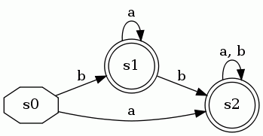
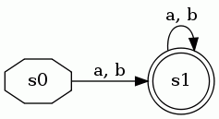
DFA Minimization
So these two DFAs are equivalent:
Both DFAs accept any combinations of a|b

Slide 29
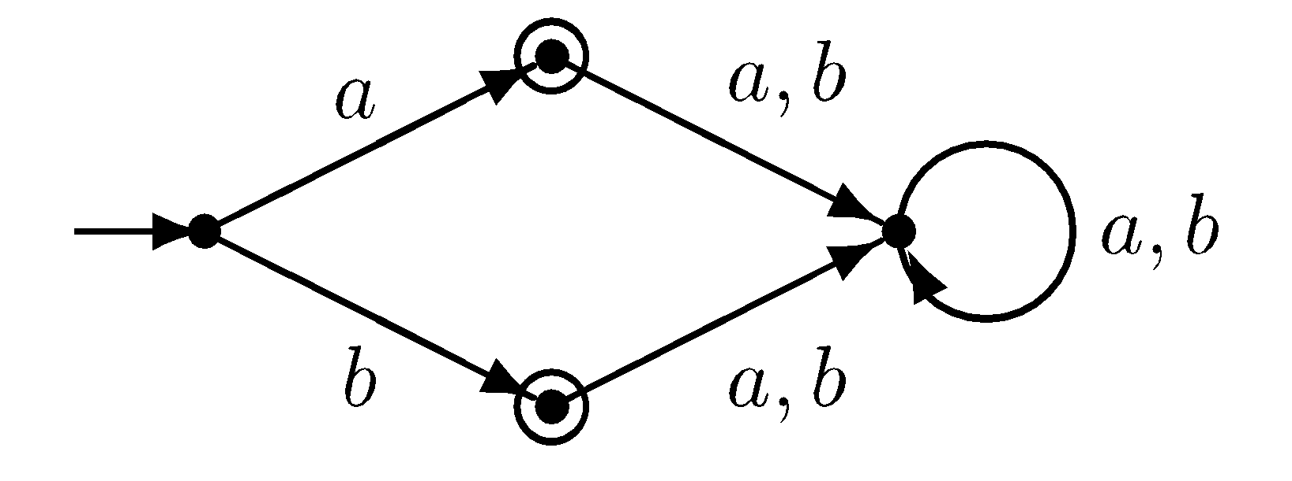
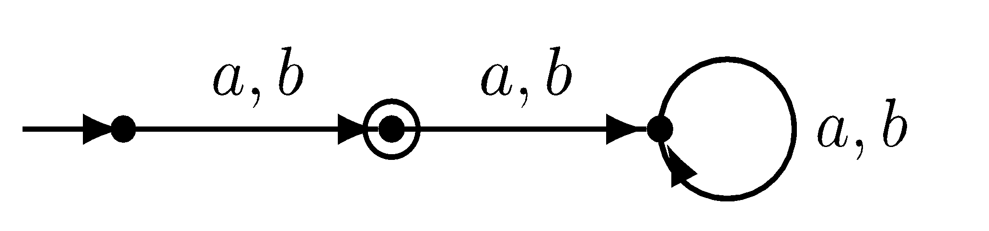
DFA Minimization

Slide 30
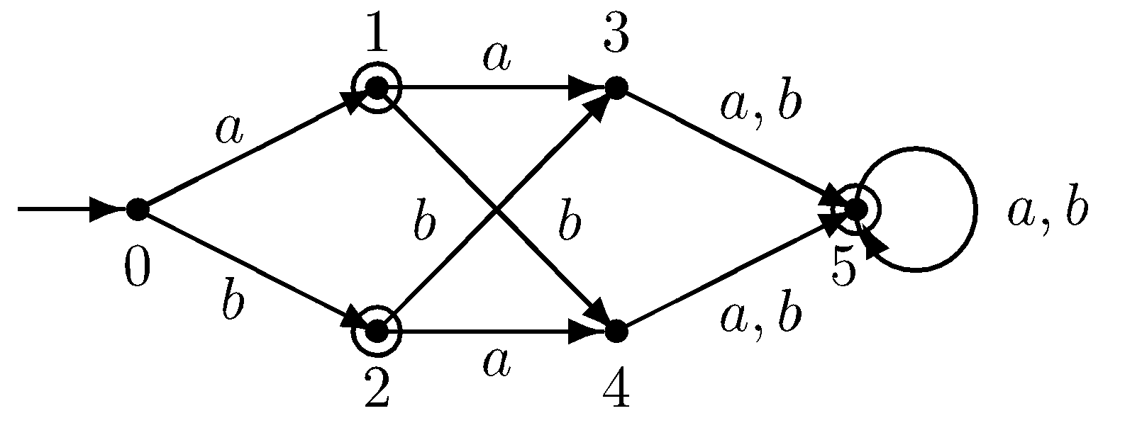
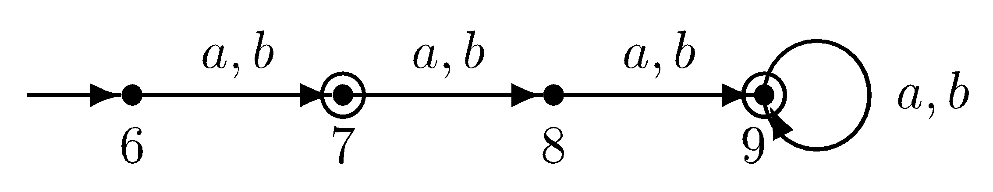
DFA Minimization

Slide 31
DFA Minimization
Recall that a DFA M=(Q, Σ, δ, q₀, F)
Two states p and q are distinct if
p in F and q not in F or vice versa, or
For any α in Σ,
δ(p, α) and δ(q, α) are distinct
Using this inductive definition, we can calculate which states are distinct

Slide 32
DFA Minimization
0, 1
1
1
B
D
F
0
0
0
1
1
1
A
C
E
0
0

Slide 33
DFA Minimization
0
0
0, 1
1
A,B
CDE
F
1

Slide 34
Thank You

